Slide 1
Title: Saving Newborn Lives at Birth through Artificial Intelligence
Draft
The Daunteless
13th December, 2021
Confidential statement

Slide 2
Agenda
Executive summary
Problem statement
Solution brief
Uniqueness of solution
Impact and scalability
Potential roadblocks
About us
Additional information (optional)

Slide 3
Executive summary
Describe your idea here (500 words max) Points to include:
Idea brief – Every year, 3 million newborns die within the first month of life. Birth asphyxia and other breathing-related conditions are a leading cause of mortality during the neonatal phase. Current diagnostic methods are too sophisticated in terms of equipment, required expertise, and general logistics. Consequently, early detection of asphyxia in newborns is very difficult in many parts of the world, especially in resource-poor settings. We are developing a machine learning system, dubbed CryCure, which enables diagnosis of asphyxia through automated analysis of the infant cry. Deployed via smartphone and wearable technology, CryCure will drastically reduce the time, cost and skill required to make accurate and potentially life-saving diagnoses.
Select stage of innovation that you are in:
Stage 3 : Design and development
1

Slide 4
Problem statement
1
Describe the problem (400 words max):
In 2016, nearly 3 million babies died within 28 days of coming into the world - the neonatal period. Birth Asphyxia has been identified by the World Health Organization (WHO) and other public health organizations as one of the top 3 causes of newborn mortality globally. It also results to severe, life-long disabilities (such as cerebral palsy, deafness, and intellectual difficulty) in over 1 million infants, annually. India contributes to the highest neonatal mortality globally. Birth asphyxia is one of the leading causes of neonatal mortality in India. A large number of neonates who suffer from birth asphyxia progress to Hypoxic Ischemic Encephalopathy (HIE). The risk of a neonate progressing to severe form of HIE is many times higher in the low and middle income countries (LMICs) with ill developed health infrastructure. Till date LMICs have had a low institutional delivery rate, poor regionalization of care, lack of adequate transport facilities and ill equipped neonatal intensive care facilities. This has lead to a tremendous burden on the health care systems with a cohort of developmentally challenged neonates surviving into adulthood. More than half of under-5 child deaths are due to diseases that are preventable and treatable through simple, affordable interventions. Unfortunately, the opportunity for early detection is limited in many resource-poor settings due to the logistics and cost of existing diagnostic system. Consequently, breathing conditions like asphyxia are generally detected only when the visual symptoms (such as pale/bluish limbs) have emerged, at which point severe neurological damage may have already occurred. Confirmatory clinical diagnosis of asphyxia involves analysis of an arterial blood sample of the infant to measure blood gases, pH, oxygen saturation and electrolytes, using a blood gas analyser. Thus, a high proportion of morbidity and mortality resulting from birth asphyxia occurs in low and middle income countries. There is need for diagnostic methods for birth asphyxia which lend themselves to early detection. Additionally, if such method is cheap, and easy to use, community health workers, midwives, nurses and even parents can use it to make life-saving diagnosis of asphyxia possible in nearly every corner of the world.
The stakeholders are health workers, midwives, nurses, and parents.
Why is this problem important to solve? (200 words):
Confirmatory clinical diagnosis of asphyxia involves analysis of an arterial blood sample of the infant to measure blood gases, pH, oxygen saturation and electrolytes, using a blood gas analyzer. This information combined with the APGAR score - a standard physical assessment of the newborns based on 5 parameters - gives conclusive evaluation of the presence and/or severity of asphyxia. Whereas blood gas analysis is a routine procedure for newborns in developed countries, in many developing regions of the world it is not. Thus, a high proportion of morbidity and mortality resulting from birth asphyxia occurs in low and middle income countries. Early detection is hard in low-resource settings due to high cost and skill required. Nurses and midwives depend on the visual signs such as pale limbs to detect Unfortunately, at this point the baby could have suffered from damage to the brain. In countries like India, Kenya, Bangladesh. Pakistan, Sri-Lanka, Thailand, Myanmar, and Thailand this is a major cause of high mortality rate of infants in these countries. Only the rich are able to afford the clinical diagnosis of asphyxia in urban cities like Bangalore, Mumbai, Lucknow, New Delhi, etc.. In semi-urban and rural areas the equipment required for the clinical diagnosis are not available and if in-case they would have been available then the people in rural areas would not have been able to afford. Our solution will work in everywhere and won’t require much resource. India has a significant shortage of trained physicians nationwide when compared to the WHO recommended ratio. Additionally, with about 80 percent of the medical workforce concentrated in top 8-10 cities and serving only 28 percent of the total population, access to healthcare still remains an aspiration for many. In rural India, a patient may have to travel even about 122 kms to meet a doctor. The need of the hour is to provide good quality healthcare access to the rural population. Also, numerous times the clinical diagnosis is too late and the infant may have develop life-long disabilities or death. Our solution is very cheap and can be made available in all the hospitals. Hence, we are solving many problems like: we will be able to detect asphyxia in poor-resource conditions, money will be saved, infants will not die, infants won’t have to struggle with life-long disabilities, and hospitals won’t have to spend much money in the training of their healthcare staff like nurses.
2

Slide 5
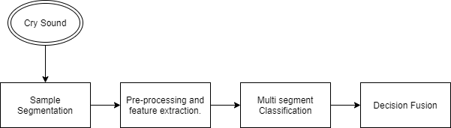
Solution brief
Elaborate your proposed solution (800 words max)
Describe your approach and/or methodology: Previous studies have hypothesized that breathing difficulty resulting from asphyxia alters the patterns in the cry waves of affected infants, largely attributed to the fact that speech and breathing are controlled by the same underlying physiologic process . Utilising the infant cry to diagnose asphyxia presents a unique opportunity for the development of a more accessible diagnostic tool. In this work, we demonstrated via a retrospective study that the infant cry provides rich source of information about the physiological state of a newborn. We will further develop a prototype mobile app which could be used in resource-poor settings to reliably detect birth asphyxia. We will use techniques from automatic speech recognition . Then we will combine features extracted as coefficients of the mel frequency spectrum with a support vector machine classifier. MFCCs are widely used in automatic speech recognition problems as they provide a representation of audio signals that closely mimic the human auditory system . SVMs are powerful classifiers that can learn complex, non-linear decision boundaries. Compared to other non-linear classifiers like neural networks, SVMs are designed to work effectively with limited examples and high-dimensional data, as is the case in our problem. Samples will be first broken down into time segments. Each segment will undergo a pre-processing (e.g., removing leading and trailing blanks) and feature extraction (as MFCC). The MFCCs will be then fed as input to the SVM classifier. A sample will be then classified as normal or asphyxia, if the majority of its segments were classified as such. We acknowledge that machine learning is only a part of the solution. For deployment, we will built a mobile application using Flutter into which we have incorporated our current model. Our solution will allow us to think deeply about our ultimate objective of deploying more accessible diagnostic tool. It will also give us opportunity to receive feedback from clinicians and other caregivers. The use of the infant cry as input for diagnosis of asphyxia presents significant economic, social and clinical benefits. Concretely, compared to the current method using a blood gas analyser, our solution is: non-invasive (requiring only cry rather than blood), low-cost (only as expensive as the cost of a phone), requires little or no skill to operate, and delivers results much quicker (under 20 seconds). Until the recent surge in deep learning methodologies, the combination of MFCC and SVMs gave some of the best performances on for speech recognition tasks . Today, recurrent neural network (RNN)-based models such as long short-term memory (LSTM) networks have led to tremendous gains on many speech and language problems . We will apply MFCC/SVM in our pilot work as it provided 2 critical advantages over a deep learning approach including feasibility of training under small number of examples and portability of model within a mobile application. As we acquire more data, and seeing that frameworks for deployment of deep models to mobile platforms are beginning to mature, we will develop deep neural networks which could potentially raise performance on this task of asphyxia detection to levels of clinical utility. If our idea gets shortlisted by ZS then our immediate focus will be to carry out data collection over a one year period (starting January 2021) at selected cities like Jaipur, Lucknow, and Kanpur. It is necessary to obtain more cry samples (especially of the pathological case) in order to train our algorithm to do better at correctly classifying new subjects. The data acquisition will serve as an opportunity to validate our current system in a real world scenario. We will continue to work on several lines of optimisations for our algorithm, namely: training for robustness to noise in the environment, finding the shortest possible record length for which we can make accurate diagnosis, optimising (math) operations to ensure that algorithm requires minimal memory and computation on mobile devices, and others.
How much of the proposed solution is already done and how much is remaining?: We obtained the Baby Chillanto Database courtesy of the National Institute of Astrophysics and Optical Electronics, CONACYT, Mexico . The database contains cries of 69 normal, asphyxiating and deaf infants (deafness is one of the most common disabilities resulting from asphyxia). Of interest to our work were the cry samples of normal and asphyxiating newborns. These were further synthesised into 1389 samples. 80% of the data was used to train and validate the algorithms while 20% was kept aside as a test set. Results on this test set showed sensitivity (accuracy in detecting asphyxiating infants) and specificity (accuracy in detecting normal infants) of 84% and 90%, respectively. Now, we are focusing on developing a cross-platform mobile app using Flutter. This app will run on both iOS and Android devices.
Is there any technology or process behind your solution? (200 words max): We are using Python as our programming language, Machine Learning, Flutter, and Firebase. The Firebase Realtime Database is a cloud-hosted NoSQL database that lets you store and sync data between your users in real-time. Our mobile app will take input such as cry sound of the infant and details, the pre-processing techniques will be applied to the input cry sound, then we will apply the above mentioned speech processing techniques, then the output will be passed to the SVM classifier. The result of the SVM classifier will be then displayed on the screen of the mobile. The data will be then stored in Firebase Database so that our model can be trained over the time.
1
2

Slide 6
Uniqueness of solution
1
Elaborate on the Novelty/Innovativeness of the idea in the chosen problem area when compared to existing solutions and ongoing research (400 words max): Our idea is unique because no other start up in India focuses on this issue. We are using the techniques of automatic speech recognition, machine learning, statistical analysis, and modern development tools such as Firebase, Flutter, Python. We are using the power of artificial intelligence to save lives. In India artificial intelligence powered healthcare systems are too costly. Some of the AI startups which focus on detecting deadly diseases such as breast cancer, etc., are OncoStem Diagnostics, SigTuple, Niramai, and Qure.ai are often very costly to use. Also, the above mentioned startups are only available in urban popular cities like Mumbai, Hyderabad, and Bengaluru. These startups don’t cover rural and semi-urban area and are out of the reach of middle class people. In India where majority of the population is middle-class and not so rich can’t afford these solutions. Further to use the solutions provided by these startups the users(here nurses) must be trained properly and as we all know that training requires a lot of money. Our solution, dubbed CryCure is non-invasive (requiring only cry rather than blood), low-cost (only as expensive as the cost of a phone), requires little or no skill to operate, and delivers results much quicker (under 20 seconds). Also, CryCure is available everywhere, from rural to urban areas inclusing semi-urban cities too. No professional training is required to use CryCure. Mutliple research paper have been published. One of the research paper is : Harnessing infant cry for swift, cost-effective diagnosis of Perinatal Asphyxia in low-resource settings (2014 IEEE Canada International Humanitarian Technology Conference - (IHTC), Therapeutic Hypothermia for Birth Asphyxia in Neonates (Datta V. Therapeutic Hypothermia for Birth Asphyxia in Neonates. Indian J Pediatr. 2017 Mar;84(3):219-226. doi: 10.1007/s12098-016-2266-0. Epub 2016 Dec 14. PMID: 27966094.)
Why should your solution be considered for the next round? (400 words max): Our solution is unique, could potentially save a lot of lives, CryCure just requires a one time investment, is cheaper then other artificial-intelligence based healthcare solutions. Our solution, dubbed as CryCure, has a potential to become a revolutionary product in the healthcare industry.CryCure can help bring the mortality rate of infants down and will help infants see the light of the day. Also, many times Asphyxia leads to severe life-long disabilities, hence CryCure will also help in avoiding these types of long-term liability. According to a report published in The Economic Times people have long-term disabilities are just limited to being a burden on their family as told by various people in a survey. Also, these people have tough time in today’s modern world. Governments need to spend a lot of money on these people which in result effects our economy too. We found 20 such studies conducted in 10 countries [1] . These studies were predominantly from high-income countries. Although studies were heterogeneous (e.g., in terms of disability measures and cost methodologies), estimated costs were sizeable and some patterns were consistent across studies. Costs varied according to the severity of disability, life cycle and household composition. Highest costs were observed among persons with severe disabilities, and among persons with disabilities living alone or in small sized households. More quantitative evidence is needed using rigorous methods, for instance evidence based on longitudinal data and as part of policy evaluations. More internationally comparable data on disability is required for the quantitative evidence to develop, especially in low- and middle-income countries where studies are scarce. Qualitative and participatory research is also needed, especially to investigate unmet needs, and the consequences of extra costs. Hence, our solution not only limited to being just an idea but a fully fledged solutions for the mentioned problems. Therefore, we think that our solution should be considered for the next round.
[1] : Sophie Mitra, Michael Palmer, Hoolda Kim, Daniel Mont, Nora Groce, Extra costs of living with a disability: A review and agenda for research, Disability and Health Journal, Volume 10, Issue 4, 2017, Pages 475-484,
ISSN 1936-6574, https://doi.org/10.1016/j.dhjo.2017.04.007. (http://www.sciencedirect.com/science/article/pii/S193665741730078X)
2

Slide 7
Impact and scalability
Provide evidence to establish confidence in the proposed idea that it will likely lead to change in status quo in the relevant area when at scale? (400 words max):
Already many startups exist in Indian, African, and other third world countries having which are using artificial intelligence for improving healthcare facilities, some of them are:
Founded in 2016, this is a startup based in Ghana, Minohealth introduced an innovative Medical Health System to democratize duality healthcare with AI for medical diagnostics, Cloud Medical Records system for hospitals, health ministries and patients, and big data analytics for health.
Founded in 2017, based in Zimbabwe, Dawa Clinic is an Artificial Intelligence-based web-mobile platform which is aimed at facilitating remote healthcare service for pregnant women and early mothers. The App works with a self-monitoring kit that empowers mothers to receive remote maternal health. Through the App, mothers are able to monitor parameters like blood pressure, Urinary Tract Infections (UTIs), blood sugar levels, and other pregnancy-related complications. The information is wired remotely to a doctor for early intervention in case of any complications. Link: https://www.dawa-health.com/
The above mentioned startups have the same artificial intelligence structure and they have already acquired funding. They are also changing the social landscape. The countries like Ghana, Zimbabwe, Kenya, Bangladesh, etc have social-economic landscape worst then India and if the above startups are working well then we think that our solution will be also able to improve the social-economic landscape. Also, India has better economy and skilled engineers, doctors, data scientists when compared to the above mentioned countries. Hence, we believe that our solution will be able to lead to change in status quo in the relevant area when at scale. When our solution would be deployed at scale then it will be much beneficial and will be able to stop the chances of life-long disabilities.
How easy will it be to adapt the solution specially with regards to meeting the growth and demand in the impacted area? (400 words max): We have already focused on the poor-resource settings so our solution won’t require much resources and cost. In future we have completely planned on migrating to Google Cloud Platform so that our product can be accessed by stakeholders from not only India but other countries well. We have also future plans of introducing region specific solutions. Hence, our product would not require much changes and edits, it can be easily transform according to meet the growth and demand. Also, we are also researching on the topic, “Using Machine Learning on cardiotocography data for fetal state analysis”. Therefore, in future our solution won’t be limited to the detection of as asphyxia, we will also aim to solve other problems related with infants. As many as 34 births and 10 deaths are registered in India every minute. The number goes up to 2,062 births and 603 deaths per hour, up to 49,481 births and 14,475 deaths per day and further up to 1.5 million births and 0.4 million deaths per month.34 infants are born every minute according to an article published in the Indian Express (Link: http://archive.indianexpress.com/news/34-births-10-deaths-are-registered-in-india-every-min/431650/#:~:text=As%20many%20as%2034%20births,0.4%20million%20deaths%20per%20month.) Our solution just takes 20 seconds to detect and predict asphyxia. So, for 34 births it would take approx 34*20=680 seconds. If our web solution is used then all the work would be sent to cloud and all the processing and other stuffs will be performed on the cloud platform. But if our mobile app is used then it would act as a standalone piece and every app would be independent of other apps. Hence, an apps can be installed to the devices in hospitals across a region, and it won’t require parallel computing power since all the processing and prediction is taking place on a device. Therefore, with meeting growth and demand we won’t require much changes or very few changes. When the device is back online then all the data would be sent to cloud where Machine Learning model will be re-trained which would make our model more robust. Then, this re-trained model will be rolled as an update to all the standalone devices at the end of a week. In this way we will be able to help a larger population and areas.
1
2

Slide 8
Potential roadblocks
1
What are the likely roadblocks this idea can face in terms of execution and implementation? (800 words max)
Data: We have a very small dataset available at the moment. We obtained the Baby Chillanto Database courtesy of the National Institute of Astrophysics and Optical Electronics, CONACYT, Mexico [7]. The database contains cries of 69 normal, asphyxiating and deaf infants (deafness is one of the most common disabilities resulting from asphyxia). Of interest to our work were the cry samples of normal and asphyxiating newborns. These were further synthesised into 1389 samples. Our immediate focus is to carry out data collection over a one year period (starting January 2021) at 3 selected sites in Lucknow, Jaipur, and Kanpur. It is necessary to obtain more cry samples (especially of the pathological case) in order to train our algorithm to do better at correctly classifying new subjects.
Next problem we have is about the consent and permission from the hospitals, researchers, and doctors. Worldwide the artificial intelligence is being adopted to help people defeat major illness. Recently, GE Healthcare Receives FDA Clearance of First Artificial Intelligence Algorithms Embedded On-Device to Prioritize Critical Chest X-ray Review (Link: https://www.ge.com/news/press-releases/ge-healthcare-receives-fda-clearance-first-artificial-intelligence-algorithms). Many healthcare AI startups in America have got FDA clearance to conduct AI based treatment of many diseases including melanoma and breast cancer.

Slide 9




About us
Presenter’s picture
Akshat Dubey
Student
Lucknow, India
+918840795943
dubeyakshat07@gmail.com
Presenter’s picture
First Last
Job title
City, Country
555.555.555
email
1
Brief description of the team members - you can specify education qualification, institute, or any other significant achievement (200 words max)
Brief description of the team members - you can specify education qualification, institute, or any other significant achievement (200 words max)
2
Why is your team best placed to solve this problem (400 words max) You can highlight relevant domain knowledge or any supporting document

Slide 10
These are optional deliverable and no marks will be deducted for not attempting this part. Participants attempting this section might have higher chances of qualifying for the next round.
Additional information (optional)

Slide 11
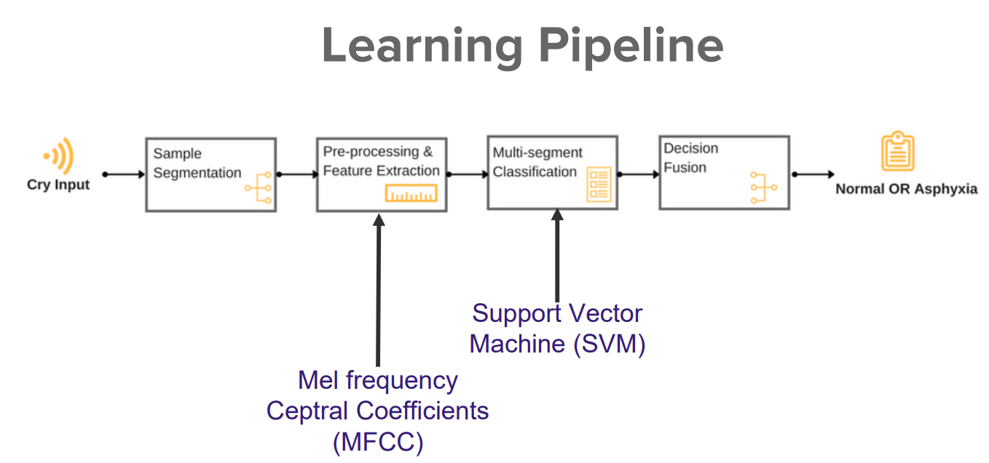
A high-level view of the diagnostic process
1

Slide 12
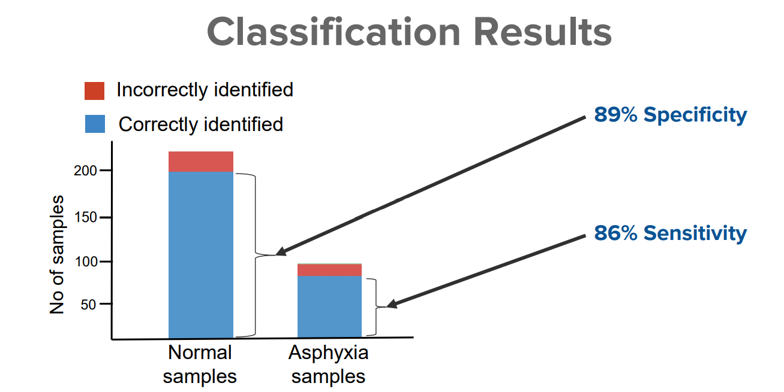
Classification Results

Slide 13
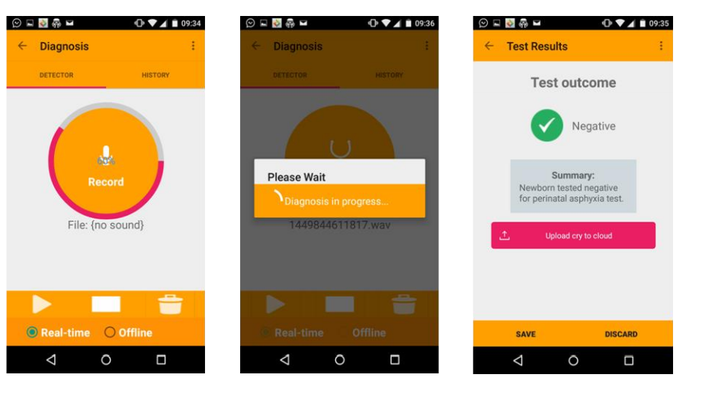
Mobile Application Interface (In Process)

Slide 14
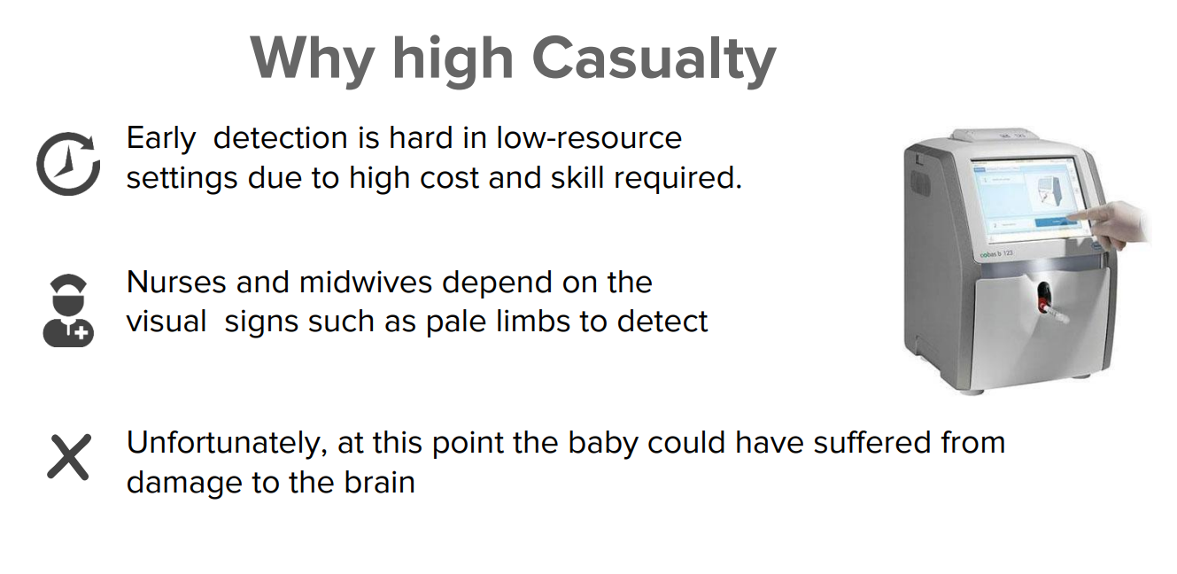
Drawbacks of the traditional solutions to identify and detect asphyxia in infants

Slide 15
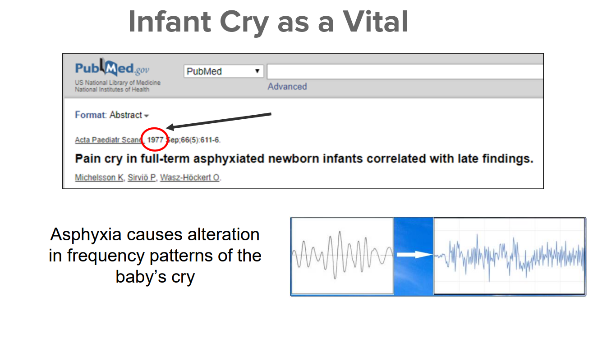
Infant cry is very vital. Asphyxia causes alteration in frequency patterns of the baby’s cry

Slide 16
Supporting documents
1
In addition, ZS would consider any evidence on user research and early user experience as a value add while considering the shortlist
Proof of concept
Market feedback on estimated solution value through user research
Early user experience feedback on solution prototype

Slide 17
Thank you!
DRAFT

